Slide 1

Introducing IPv6
BSCI Module 8 Lessons 1 and 2

Slide 2
IPv6 Advanced Features
Larger address space
Global reachability and flexibility
Aggregation
Autoconfiguration
Plug-and-play
End to end without NAT
Simpler header
Routing efficiency
Performance and forwarding rate scalability
No broadcasts
No checksums
Extension headers
Mobility and security
Mobile IP RFC-compliant
IPSec mandatory
(or native) for IPv6
Transition richness
Dual stack
6to4 tunnels
Notes:
IPv6 is a powerful enhancement to IPv4. There are several features in IPv6 that offer functional improvements. What IP developers learned from using IPv4 suggested changes to better suit current and foreseeable network demands:
Larger address space: Larger address space includes several enhancements: improved global reachability and flexibility; the aggregation of prefixes that are announced in routing tables; multihoming to several Internet service providers (ISPs); autoconfiguration that can include link-layer addresses in the address space; plug-and-play options; and public-to private readdressing end to end without address translation; and simplified mechanisms for address renumbering and modification.
Simpler header: A simpler header offers several advantages over IPv4: better routing efficiency for performance and forwarding-rate scalability; no broadcasts and thus no potential threat of broadcast storms; no requirement for processing checksums; simpler and more efficient extension header mechanisms; and flow labels for per-flow processing with no need to open the transport inner packet to identify the various traffic flows.

Slide 3
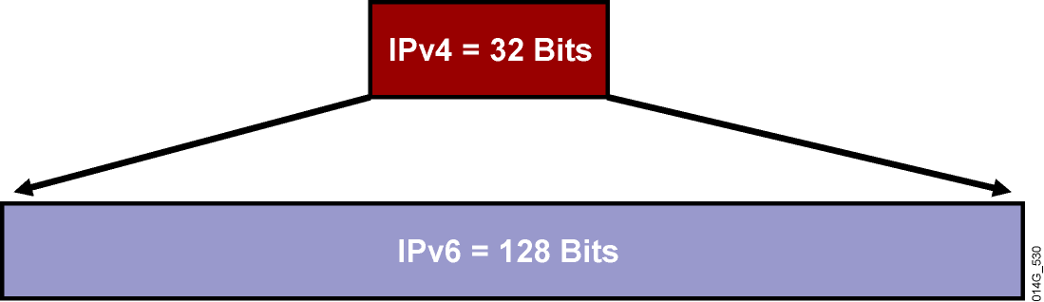
Larger Address Space
IPv4
32 bits or 4 bytes long
    4,200,000,000 possible addressable nodes
IPv6
128 bits or 16 bytes: four times the bits of IPv4
    3.4 * 10³⁸ possible addressable nodes
    340,282,366,920,938,463,374,607,432,768,211,456
    5 * 10²⁸ addresses per person
~
=
~
=
~
=
~
=
Notes:
IPv6 increases the number of address bits by a factor of 4, from 32 to 128. This factor enables a very large number of addressable nodes; however, as in any addressing scheme, not all the addresses are used or available.
Current IPv4 protocol address use is extended by applying techniques such as NAT and temporary address allocations. But the manipulation of data payload by intermediate devices challenges (or complicates) the advantages of peer-to-peer communication, end-to-end security, and quality of service (QoS).
IPv6 gives every user multiple global addresses that can be used for a wide variety of devices, including cell phones, personal digital assistants (PDAs), and IP-enabled vehicles. Quadrupling the available 32-bit IPv4 address space to 128 bits, IPv6 addresses the need for always-on environments. These addresses are reachable without using IP address translation, pooling, and temporary allocation techniques.
Increasing the number of bits for the address also increases the IPv6 header size. Because each IP header contains a source and a destination address, the size of the header fields that contains the addresses is 256 bits for IPv6 compared to 64 bits for IPv4.
Note: For more IETF information on IPv6 addressing details, refer to RFC 3513.

Slide 4
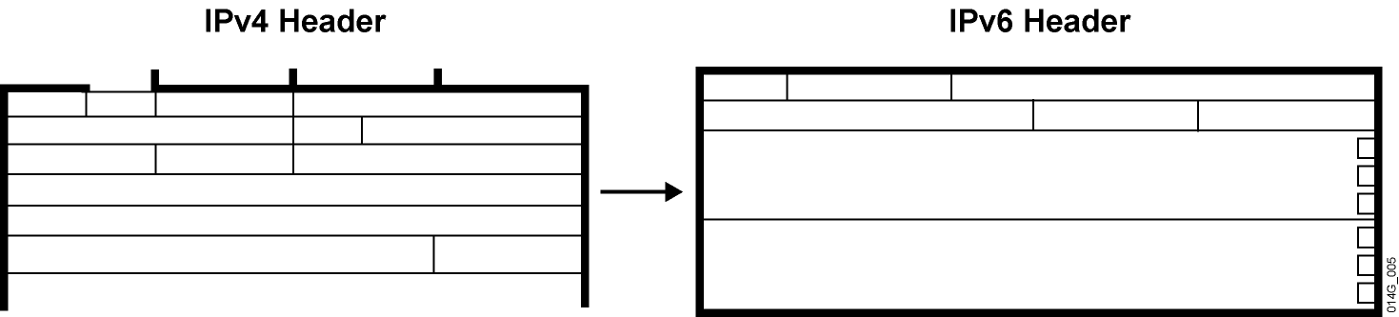
Simple and Efficient Header
A simpler and more efficient header means:
64-bit aligned fields and fewer fields
Hardware-based, efficient processing
Improved routing efficiency and performance
Faster forwarding rate with better scalability
Notes:
The IP version 4 (IPv4) header contains 12 basic header fields, followed by an options field and a data portion (usually the transport layer segment). The basic IPv4 header has a fixed size of 20 octets. The variable-length options field increases the size of the total IP header. IPv6 contains 5 of the 12 IPv4 basic header fields. The IPv6 header does not require the other seven fields.

Slide 5
MTU Issues
Minimum link MTU for IPv6 is 1280 octets
(vs. 68 octets for IPv4).
  On links with MTU < 1280, link-specific fragmentation and reassembly must be used
Implementations are expected to perform path MTU discovery to send packets bigger than 1280.
Minimal implementation can omit PMTU discovery as long as all packets kept ≤ 1280 octets.
A hop-by-hop option supports transmission of “jumbograms” with up to 2³² octets of payload.
Notes:
Routers handle fragmentation in IPv4, which causes a variety of processing issues. IPv6 routers no longer perform fragmentation. Instead, a discovery process is used to determine the optimum maximum transmission unit (MTU) to use during a given session.
In the discovery process, the source IPv6 device attempts to send a packet at the size that is specified by the upper IP layers, for example, the transport and application layers.
If the device receives an “ICMP packet too big” message, it retransmits the MTU discover packet with a smaller MTU and repeats the process until it gets a response that the discover packet arrived intact. Then it sets the MTU for the session.
The “ICMP packet too big” message contains the proper MTU size for the pathway. Each source device needs to track the MTU size for each session. Generally, the tracking is done by creating a cache that is based on the destination address; however, it can also be done by using the flow label. If source-based routing is performed, the tracking of the MTU size can be done by using the source address.
The discovery process is beneficial because, as routing pathways change, a new MTU might be more appropriate. When a device receives an “ICMP packet too big” message, it decreases its MTU size if the Internet Control Message Protocol (ICMP) message contains a recommended MTU that is less than the current MTU of the device.
A device performs an MTU discovery every 5 minutes to see whether the MTU has increased along the pathway. Application and transport layers for IPv6 accept MTU reduction notifications from the IPv6 layer.
If they do not accept the notifications, IPv6 has a mechanism to fragment packets that are too large; however, upper layers are encouraged to avoid sending messages that require fragmentation.
Link-layer technologies already perform checksum and error control. Because link-layer technologies are relatively reliable, an IP header checksum is considered to be redundant. Without the IP header checksum, the upper-layer optional checksums, such as User Datagram Protocol (UDP), are now mandatory.

Slide 6
IPv4 and IPv6 Header Comparison
IPv4 Header
IPv6 Header
Version
IHL
Type of
Service
Total Length
Version
Traffic
Class
Flow Label
Identification
Flags
Fragment
Offset
Payload Length
Next
Header
Hop Limit
Time to Live
Protocol
Header Checksum
Source Address
Source Address
Destination Address
Options
Padding
Field’s Name Kept from IPv4 to IPv6
Fields Not Kept in IPv6
Name and Position Changed in IPv6
New Field in IPv6
Destination Address
Legend
Notes:
Streamlined
Fragmentation fields moved out of base header
IP options moved out of base header
Header Checksum eliminated
Header Length field eliminated
Length field excludes IPv6 header
Alignment changed from 32 to 64 bits
Revised
Time to Live → Hop Limit
Protocol → Next Header
Precedence and TOS → Traffic Class
Addresses increased 32 bits → 128 bits
Extended
Flow Label field added
The IPv6 header has 40 octets in contrast to the 20 octets in IPv4. IPv6 has a smaller number of fields, and the header is 64-bit aligned to enable fast processing by current processors. Address fields are four times larger than in IPv4.
The IPv6 header contains these fields:
Version: A 4-bit field, the same as in IPv4. It contains the number 6 instead of the number 4 for IPv4.
Traffic Class: An 8-bit field similar to the type of service (ToS) field in IPv4. It tags the packet with a traffic class that it uses in differentiated services (DiffServ). These functionalities are the same for IPv6 and IPv4.
Flow Label: A completely new 20-bit field. It tags a flow for the IP packets. It can be used for multilayer switching techniques and faster packet-switching performance.
Payload Length: Similar to the Total Length field of IPv4.
Next Header: The value of this field determines the type of information that follows the basic IPv6 header. It can be a transport-layer packet, such as TCP or UDP, or it can be an extension header. The next header field is similar to the Protocol field of IPv4.
Hop Limit: This field specifies the maximum number of hops that an IP packet can traverse. Each hop or router decreases this field by one (similar to the Time to Live [TTL] field in IPv4). Because there is no checksum in the IPv6 header, the router can decrease the field without recomputing the checksum. On IPv4 routers the recomputation costs processing time.
Source Address: This field has 16 octets or 128 bits. It identifies the source of the packet.
Destination Address: This field has 16 octets or 128 bits. It identifies the destination of the packet.
Extension Headers: The extension headers, if any, and the data portion of the packet follow the eight fields. The number of extension headers is not fixed, so the total length of the extension header chain is variable.

Slide 7
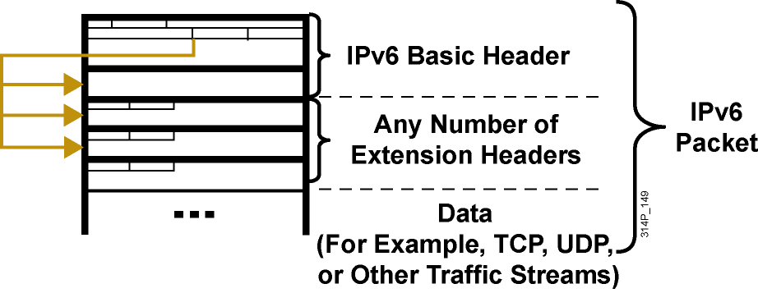
IPv6 Extension Headers
Simpler and more efficient header means:
IPv6 has extension headers.
IPv6 handles the options more efficiently.
IPv6 enables faster forwarding rate and end nodes processing.
Notes:
There are many types of extension headers. When multiple extension headers are used in the same packet, the order of the headers should be as follows:
IPv6 header: This header is the basic header described in the previous figure.
Hop-by-hop options header: When this header is used for the router alert (Resource Reservation Protocol [RSVP] and Multicast Listener Discovery version 1 [MLDv1]) and the jumbogram, this header (value = 0) is processed by all hops in the path of a packet. When present, the hop-by-hop options header always follows immediately after the basic IPv6 packet header.
Destination options header (when the routing header is used): This header (value = 60) can follow any hop-by-hop options header, in which case the destination options header is processed at the final destination and also at each visited address specified by a routing header. Alternatively, the destination options header can follow any Encapsulating Security Payload (ESP) header, in which case the destination options header is processed only at the final destination. For example, mobile IP uses this header.
Routing header: This header (value = 43) is used for source routing and mobile IPv6.
Fragment header: This header is used when a source must fragment a packet that is larger than the MTU for the path between itself and a destination device. The fragment header is used in each fragmented packet.
Authentication header and Encapsulating Security Payload header: The authentication header (value = 51) and the ESP header (value = 50) are used within IPsec to provide authentication, integrity, and confidentiality of a packet. These headers are identical for both IPv4 and IPv6.
Upper-layer header: The upper-layer (transport) headers are the typical headers used inside a packet to transport the data. The two main transport protocols are TCP (value = 6) and UDP (value = 17).

Slide 8
IPv6 Address Representation
x:x:x:x:x:x:x:x, where x is a 16-bit hexadecimal field
Leading zeros in a field are optional:
  2031:0:130F:0:0:9C0:876A:130B
Successive fields of 0 can be represented as ::, but only once per address.
Examples:
  2031:0000:130F:0000:0000:09C0:876A:130B
  2031:0:130f::9c0:876a:130b
  FF01:0:0:0:0:0:0:1 >>> FF01::1
  0:0:0:0:0:0:0:1 >>> ::1
  0:0:0:0:0:0:0:0 >>> ::
Notes:
IPv6 addresses are shown in hexadecimal and there are appropriate methods for abbreviation of addresses. Colons separate entries in a series of 16-bit hexadecimal fields that represent IPv6 addresses. The hexadecimal digits A, B, C, D, E, and F represented in IPv6 are not case-sensitive. IPv6 does not require explicit address string notation.
Use the following guidelines for IPv6 address string notations:
The leading zeros in a field are optional, so that 09C0 = 9C0 and 0000 = 0.
Successive fields of zeros can be represented as “::” only once in an address.
An unspecified address is written as “::” because it contains only zeros.
Using the “::” notation greatly reduces the size of most addresses. For example, FF01:0:0:0:0:0:0:1 becomes FF01::1.
Note: An address parser identifies the number of missing zeros by separating the two parts and entering 0 until the 128 bits are complete. If two “::” notations are placed in the address, there is no way to identify the size of each block of zeros.

Slide 9
IPv6—Addressing Model
Addresses are assigned to interfaces
  Change from IPv4 mode:
Interface “expected” to have multiple addresses
Addresses have scope
  Link Local
  Unique Local
  Global
Addresses have lifetime
  Valid and preferred lifetime
Global
Unique Local
Link Local
Notes:
Now we know how to represent IPv6 in IPv6 format lets look at the IPv6 addressing model

Slide 10
IPv6 Address Types
Unicast
  Address is for a single interface.
  IPv6 has several types (for example, global and IPv4 mapped).
Multicast
  One-to-many
  Enables more efficient use of the network
  Uses a larger address range
Anycast
  One-to-nearest (allocated from unicast address space).
  Multiple devices share the same address.
  All anycast nodes should provide uniform service.
  Source devices send packets to anycast address.
  Routers decide on closest device to reach that destination.
  Suitable for load balancing and content delivery services.
Notes:
Broadcasting in IPv4 results in a number of problems. Broadcasting generates a number of interrupts in every computer on the network and, in some cases, triggers malfunctions that can completely halt an entire network. This disastrous network event is known as a “broadcast storm.”
In IPv6, broadcasting does not exist. Broadcasts are replaced by multicasts and anycasts. Multicast enables efficient network operation by using a number of functionally specific multicast groups to send requests to a limited number of computers on the network. The multicast groups prevent most of the problems that are related to broadcast storms in IPv4.
The range of multicast addresses in IPv6 is larger than in IPv4. For the foreseeable future, allocation of multicast groups is not being limited.
IPv6 also defines a new type of address called an anycast address. An anycast address identifies a list of devices or nodes; therefore, an anycast address identifies multiple interfaces. A packet sent to an anycast address is delivered to the closest interface—as defined by the routing protocols in use—identified by the anycast address.
Anycast addresses are syntactically indistinguishable from global unicast addresses because anycast addresses are allocated from the global unicast address space.
Note: Anycast addresses must not be used as the source address of an IPv6 packet.

Slide 11
IPv6 Global Unicast (and Anycast)
Addresses
The global unicast and the anycast share the same address format.
Uses a global routing prefix—a structure that enables aggregation upward, eventually to the ISP.
A single interface may be assigned multiple addresses of any type (unicast, anycast, multicast).
Every IPv6-enabled interface must contain at least one loopback (::1/128) and one link-local address.
Optionally, every interface can have multiple unique local and global addresses.
Anycast address is a global unicast address assigned to a set of interfaces (typically on different nodes).
IPv6 anycast is used for a network multihomed to several ISPs that have multiple connections to each other.
Notes:
The global unicast and the anycast share the same address format. The unicast address space allocates the anycast addresses. To devices that are not configured for anycast, these addresses appear as unicast addresses.
When a unicast address is assigned to more than one interface, thus turning it into an anycast address, the nodes to which the address is assigned must be explicitly configured to use and recognize the anycast address.
A packet that is sent to an anycast address routes to the closest device or interface that shares this address. A sender creates a packet with the anycast as the destination address and forwards it to its nearest router. The source can use the anycast addresses to control the pathway across which traffic flows.
Examples: Multiple ISPs and LANs with Multiple Routers
An example of anycast use in a Border Gateway Protocol (BGP) multihomed network is when a customer has multiple ISPs with multiple connections to one another. The customer can configure a different anycast address for each ISP.
Each router for the given ISP has the same configured anycast address. The source device can choose which ISP to send the packet to; however, the routers along the path determine the closest router to reach that ISP using the IPv6 anycast address.
Another use for an anycast is when a LAN is attached to multiple routers. These routers can have the same IPv6 anycast address so that distant devices need to identify only the anycast address. Intermediate devices can choose the best pathway to reach the closest entry point to that subnet.

Slide 12
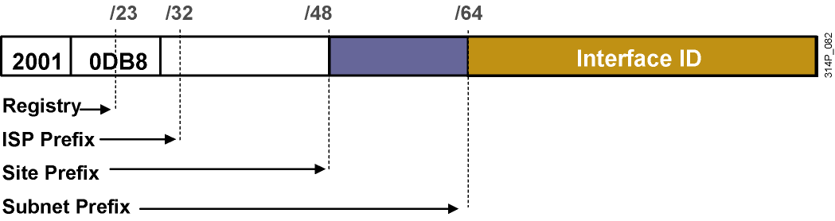
IPv6 Global Unicast Addresses (Cont.)
Global unicast and anycast addresses are defined by a global routing prefix, a subnet ID, and an interface ID.
Notes:
The IPv6 global unicast address is the equivalent of the IPv4 global unicast address. A global unicast address is an IPv6 address from the global unicast prefix. The structure of global unicast addresses enables aggregation of routing prefixes that limits the number of routing table entries in the global routing table. Global unicast addresses used on links are aggregated upward through organizations and eventually to the Internet service providers (ISPs).
Global unicast addresses are defined by a global routing prefix, a subnet ID, and an interface ID.

Slide 13
IPv6 Unicast Addressing
IPv6 addressing rules are covered by multiple RFCs.
  Architecture defined by RFC 4291.
Unicast: One to one
  Global
  Link local (FE80::/10)
A single interface may be assigned multiple IPv6 addresses of any type: unicast, anycast, or multicast.
Notes:
The IPv6 unicast address space encompasses the entire IPv6 address range, with the exception of FF00::/8 (1111 1111), which is used for multicast addresses. The current global unicast address assignment by the Internet Assigned Numbers Authority (IANA) uses the range of addresses that start with binary value 001 (2000::/3), which is one-eighth of the total IPv6 address space and is the largest block of assigned block addresses.
Addresses with a prefix of 2000::/3 (001) through E000::/3 (111), with the exception of the FF00::/8 (1111 1111) multicast addresses, are required to have 64-bit interface identifiers in the extended universal identifier (EUI)-64 format.
The IANA is allocating the IPv6 address space in the ranges of 2001::/16 to the registries.
The global unicast address typically consists of a 48-bit global routing prefix and a 16-bit subnet ID. In the now obsolete RFC 2374, An IPv6 Aggregatable Global Unicast Address Format, the global routing prefix included two other hierarchically structured fields called Top‑Level Aggregator and Next-Level Aggregator. Because these fields were policy-based, the Internet Engineering Task Force (IETF) decided to remove them from the RFCs. However, some existing IPv6 networks deployed in the early days might still be using networks based on the older architecture. A 16-bit subnet field called Subnet ID could be used by individual organizations to create their own local addressing hierarchy and to identify subnets. This field allows an organization to use up to 65,535 individual subnets. (RFC 2374 has now been replaced by RFC 3587, IPv6 Aggregatable Global Unicast Address Format.)

Slide 14
Aggregatable Global Unicast Addresses
Provider
Site
Host
3
45 Bits
16 Bits
64 Bits
Global Routing Prefix
Subnet
Interface ID
001
Aggregatable Global Unicast Addresses Are:
Addresses for generic use of IPv6
Structured as a hierarchy to keep the aggregation
Notes:
The Aggregatable Global Unicast Addresses correspond to the principal use of IPv6 addresses for the generic IPv6 traffic and consume the most important part of the address space. The structure enables strict aggregation of routing prefixes in order to limit the number of routing table entries in the global routing table.

Slide 15
IPv6 Interface ID
Cisco uses the extended universal identifier (EUI)-64 format to do stateless autoconfiguration.
This format expands the 48-bit MAC address to 64 bits by inserting “FFFE” into the middle 16 bits.
To make sure that the chosen address is from a unique Ethernet MAC address, the universal/local (U/L bit) is set to 1 for global scope (0 for local scope).
Notes:
Use of EUI-64 Format in IPv6 Addresses
The 64-bit interface identifier is an IPv6 address is used to identify a unique interface on a link. A link is a network medium over which network nodes communicate using the link layer. The interface identifier may also be unique over a broader scope. In many cases, an interface identifier will be the same as or is based on the link-layer (MAC) address of an interface. As in IPv4, a subnet prefix in IPv6 is associated with one link.
Interface identifiers used in global unicast and other IPv6 address types must be 64 bits long and constructed in the Extended Universal Identifier (EUI)-64 format. The EUI-64 format interface ID is derived from the 48-bit link-layer (MAC) address by inserting the hexadecimal number FFFE between the upper 3 bytes (Organizational Unique Identifier [OUI] field) and the lower 3 bytes (serial number) of the link layer address. To make sure that the chosen address is from a unique Ethernet MAC address, the seventh bit in the high-order byte is set to 1 (equivalent to the IEEE G/L bit) to indicate the uniqueness of the 48-bit address.

Slide 16
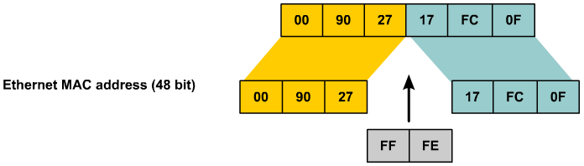
MAC Address to EUI-64
Notes:
MAC Address to Modified EUI-64 to IPv6 Interface Identifier
The IPv6 interface identifier for stateless auto-configuration in an Ethernet environment uses the modified EUI-64 format. The transformation begins by taking the MAC address of the interface.
This format expands the 48-bit Ethernet MAC address format to a 64-bit version by inserting "FFFE" in the middle of the 48 bits.
This creates a 64-bit, unique interface identifier.
The 7th bit (starting with the leftmost bit as “1”) in an IPv6 interface identifier is referred to as the Universal/Local bit, or U/L bit.
This bit identifies whether this interface identifier is locally unique on the link or that it is universally unique.
To make sure that the chosen address is from a unique Ethernet MAC address, the universal/local (“u” bit) is set to 1 for global scope and 0 for local scope.
In the case where the interface identifier is created from an Ethernet MAC address, it is assumed that the MAC address is universally unique and, therefore, the interface identifier is universally unique.
The rationale of the U/L bit is for future use of the upper-layer protocols to uniquely identify a connection, even in the context of a change in the leftmost part of the address. However, this is not yet used.
The 8th bit (starting with leftmost bit as “1”), also known as the “G” bit, is a group/individual bit for managing groups. The unicast/group (“g” bit) is set to 1 for group and 0 for unicast.
Because of certain privacy and security concerns, the implementation of autoconfiguration by a host may also create a random interface identifier using the MAC address as a base. This is considered a privacy extension because, without it, creating an interface identifier from a MAC address provides the ability to track the activity and point of connection.
Microsoft Windows XP is currently the only known implementation of this capability and prefers to use this address for outgoing communication, because the address has a short lifetime and will be regenerated periodically.
Note: This process is defined in RFC 3041.

Slide 17
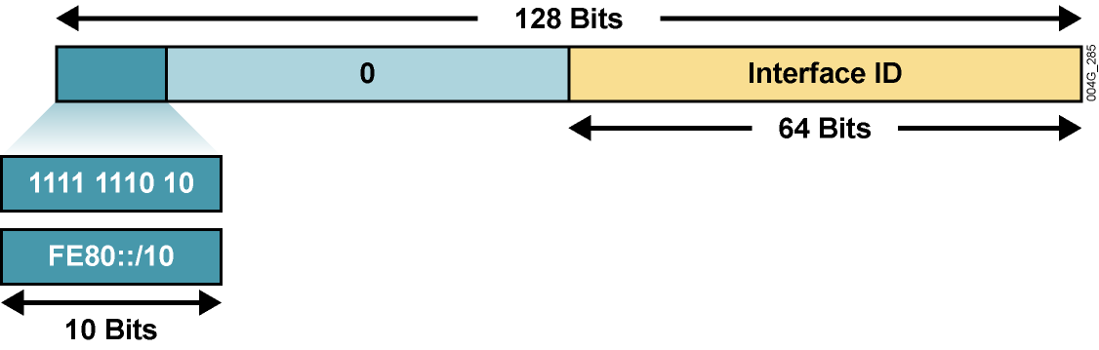
Link-Local Address
Remaining 54 bits
Mandatory address for communication between two IPv6 devices (similar to ARP but at Layer 3)
Automatically assigned by router as soon as IPv6 is enabled
Also used for next-hop calculation in routing protocols
Only link specific scope
Remaining 54 bits could be zero or any manual configured value
Notes:
Link-local addresses have a scope limited to the link and are dynamically created on all IPv6 interfaces by using a specific link-local prefix FE80::/10 and a 64-bit interface identifier.
Interface identifiers in IPv6 addresses are used to identify interfaces on a link. They may also be thought of as the “host portion” of an IPv6 address. Interface identifiers are required to be unique on that link.
Interface identifiers are always 64 bits and are dynamically created based on Layer 2 media and encapsulation.
Link-local addresses are used for automatic address configuration, neighbor discovery, and router discovery. Link-local addresses are also used by many routing protocols.
Link-local addresses can serve as a way to connect devices on the same local network without needing global addresses.
Interface identifiers may also be unique over a broader scope: When the interface identifier is derived directly from the data link layer address of the interface (for example, IEEE 802.1Q MAC), the scope of that identifier is assumed to be universal (global).
When communicating with a link-local address, you must specify the outgoing interface because every interface is connected to FE80::/10.
IPv6 over Data Link Layers
IPv6 is defined on most of the current data link layers, including the following:
Ethernet*
PPP*
High-Level Data Link Control (HDLC)*
FDDI
Token Ring
Attached Resource Computer Network (ARCNET)
Nonbroadcast multiaccess (NBMA)
ATM**
Frame Relay***
IEEE 1394
* Cisco supports these data link layers.
** Cisco supports only ATM permanent virtual circuit (PVC) and ATM LAN Emulation (LANE).
*** Cisco supports only Frame Relay PVC.
An RFC describes the behavior of IPv6 in each of these specific data link layers, but Cisco IOS software does not necessarily support all of them. The data link layer defines how IPv6 interface identifiers are created and how neighbor discovery deals with data link layer address resolution.

Slide 18
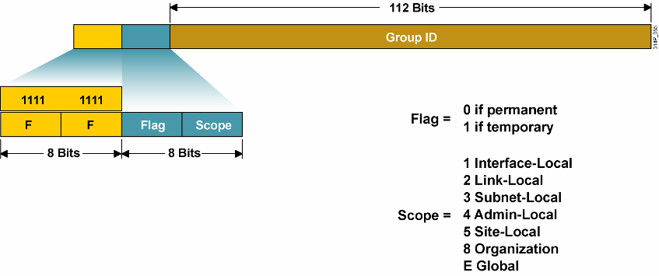
Multicasting
Multicast is frequently used in IPv6 and replaces broadcast.
Notes:
A multicast address identifies a group of interfaces. Traffic sent to a multicast address travels to multiple destinations at the same time. An interface may belong to any number of multicast groups. Multicasting is extremely important to IPv6, because it is at the core of many IPv6 functions.
IPv6 multicast addresses are defined by the prefix FF00::/8. The second octet defines the lifetime (flag) and the scope of the multicast address.
The flag parameter is equal to 0 for a permanent, or well-known, multicast address. For a temporary multicast address, the flag is equal to 1.
The scope parameter is equal to 1 for the scope of the interface (loopback transmission), 2 for the link scope (similar to unicast link-local scope), 3 for subnet-local scope where subnets may span multiple links, 4 for admin-local scope (administratively configured), 5 for the site scope, 8 for the organizational scope (multiple sites), and E for the global scope. For example, a multicast address starting with FF02::/16 is a permanent multicast address with a link-local scope.
The multicast group ID consists of the lower 112 bits of the multicast address.
Multicast is frequently used in IPv6 and replaces broadcast. There is no broadcast in IPv6.
There is no Time to Live (TTL) in IPv6 multicast. The scoping is defined inside the address.

Slide 19
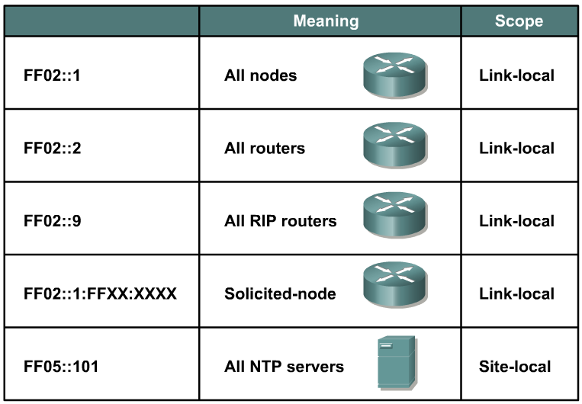
Examples of Permanent Multicast Addresses
Notes:
The multicast addresses, FF00:: to FF0F::, are reserved. Within that range, the following are some examples of assigned addresses (there are many more assignments made; assignments are tracked by the Internet Assigned Numbers Authority [IANA]):
FF02::1 — All nodes on link (link-local scope)
FF02::2 — All routers on link
FF02::5 — All OSPF routers on link
FF02::6 — All DR routers on link
FF02::9 — All Routing Information Protocol (RIP) routers on link
FF02::1:FFXX:XXXX — Solicited-node multicast on link, where XX:XXXX is the rightmost 24 bits of the corresponding unicast or anycast address of the node. (Neighbor solicitation messages are sent on a local link when a node wants to determine the link-layer address of another node on the same local link, similar to Address Resolution Protocol [ARP] in IPv4.)
FF05::101 — All Network Time Protocol (NTP) servers in the site (site-local scope)
The site-local multicast scope has an administratively assigned radius and has no direct correlation to the (now deprecated) site-local unicast prefix of FEC0::/10.

Slide 20
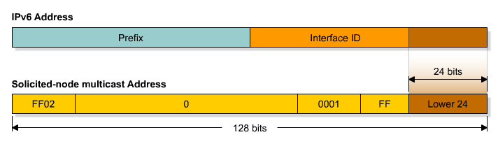
Solicited-Node Multicast Address
Used in neighbor solicitation messages
Multicast address with a link-local scope
Solicited-node multicast consists of prefix + lower 24 bits from unicast, FF02::1:FF:
Notes:
Solicited-node Address
Solicited-node addresses are multicast addresses used in neighbor solicitation messages to help with neighbor discovery. An IPV6 node must join the multicast group corresponding to each of its unicast and anycast addresses. The solicited-node address is composed of the following: FF02:0:0:0:0:1:FF/104 prefix concatenated by the rightmost 24 bits of the corresponding unicast or anycast address of the node. As a FF02::/16 address, a solicited-node multicast address has the scope of link-local.
In very rare cases, the rightmost 24 bits of the unicast address of the target will not be unique on the link. Solicited–node multicast addresses are used in IPv6 for address resolution of an IPv6 address to a MAC address on a LAN segment. For example, consider two nodes with addresses 2001:DB8:200:300:400:500:aaaa:bbbb and 2001:DB8:200:300:400:501:aaaa:bbbb, where the link prefix is 2001:DB8:200:300::/64. These two nodes, then, would be listening to the same solicited-node multicast address. Each would receive the multicast packet, but only the node whose full address matched the full target address of the multicast packet (embedded in the data field of the multicast packet) would respond with a neighbor advertisement (which includes the actual MAC address). The other node would receive the multicast packet, but upon inspection of the embedded target address would realize that it was not the intended recipient of the request, and would not respond.
The following example describes how this situation would work.
Node A has this characteristic:
Address 2001:DB8:200:300:400:500:1234:5678
Node B has these characteristics:
Address 2001:DB8:200:300:500:AAAA:BBBB
Solicited-node multicast address FF02:0:0:0:0:1:FFAA:BBBB (the same as node C)
Node C has these characteristics:
Address 2001:DB8:200:300:501:AAAA:BBBB
Solicited-node multicast address FF02:0:0:0:0:1:FFAA:BBBB (the same as node B)
Node A desires to exchange packets with node B. Node A sends a neighbor discovery packet to the solicited-node multicast address of B, FF02:0:0:0:0:1:AAAA:BBBB, as described previously. Inside the packet, in addition to other data, is the full IPv6 address that node A is looking for—2001:DB8:200:300:500:AAAA:BBBB. This is called the target address.
Both node B and node C are listening to the same multicast address, so they both receive and process the packet.
Node B sees that the target address inside the packet is its own and responds as described previously.
Node C sees that the target address inside the packet is not its own and does not respond
at all.
In this manner, nodes can have the same solicited-node multicast address on the link without causing neighbor discovery, neighbor solicitation, or neighbor advertisement to malfunction.

Slide 21
Router Interface
R1#sh ipv6 int e0
Ethernet0 is up, line protocol is up
IPv6 is enabled, link-local address is FE80::200:CFF:FE3A:8B18
No global unicast address is configured
Joined group address(es):
FF02::1
FF02::2
FF02::1:FE3A:8B18
MTU is 1500 bytes
ICMP error messages limited to one every 100 milliseconds
ICMP redirects are enabled
ND DAD is enabled, number of DAD attempts: 1
ND reachable time is 30000 milliseconds
ND advertised reachable time is 0 milliseconds
ND advertised retransmit interval is 0 milliseconds
ND router advertisements are sent every 200 seconds
ND router advertisements live for 1800 seconds
Hosts use stateless autoconfig for addresses.
R1#
Solicited-Node Multicast Address

Slide 22
Anycast
An IPv6 anycast address is a global unicast address that is assigned to more than one interface.
Notes:
An IPv6 anycast address is a global unicast address that is assigned to more than one interface. When a packet is sent to an anycast address, it is routed to the “nearest” interface having that address. In a WAN scope, the nearest interface is found according to the measure of distance of the routing protocol. In a LAN scope, the nearest interface is found according to the first neighbor that is learned about. The following describes the characteristics of the anycast:
Anycast addresses are allocated from the unicast address space, so they are indistinguishable from the unicast address. When assigned to a node interface, the node must be explicitly configured to know that the address is an anycast address.
The idea of anycast in IP was proposed in 1993. For IPv6, anycast is defined as a way to send a packet to the nearest interface that is a member of the anycast group, which enables a type of discovery mechanism to the nearest point.
There is little experience with widespread anycast usage. A few anycast addresses are currently assigned: the router-subnet anycast and the Mobile IPv6 home agent anycast.
An anycast address must not be used as the source address of an IPv6 packet.

Slide 23
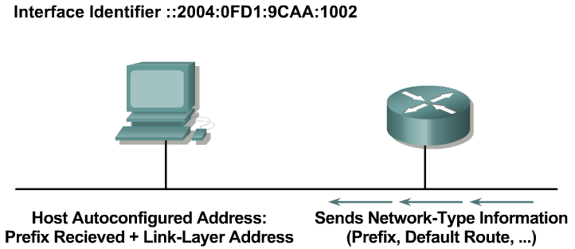
Stateless Autoconfiguration
A router sends network information to all the nodes on the local link.
A host can autoconfigure itself by appending its IPv6 interface identifier (64-bit format) to the local link prefix (64 bits).
The result is a full 128-bit address that is usable and guaranteed to be globally unique.
Notes:
A router on the local link can send network information, such as a 64-bit prefix of the local link network and the default route. It sends this to all the nodes on the local link. A host can autoconfigure itself by appending its IPv6 interface identifier (64-bit format) to the local link prefix (64 bits). This process results in a full 128-bit address that is usable and guaranteed to be globally unique.
A process called duplicate address translation is enabled to detect and avoid duplicate addresses.
Autoconfiguration enables the plug-and-play feature, which allows devices to connect themselves to the network without any configuration and without any servers (like DHCP servers). This key feature enables deployment of new devices on the Internet, such as cellular phones, wireless devices, home appliances, and home networks.
Note: Stateless DHCP is a new concept (February 2004) that strikes a middle ground between stateless autoconfiguration and the thick-client approach of stateful DHCP. Stateless DHCP for IPv6 is also called “DHCP-lite.” See RFC 3736, Stateless Dynamic Host Configuration Protocol (DHCP) Service for IPv6.

Slide 24
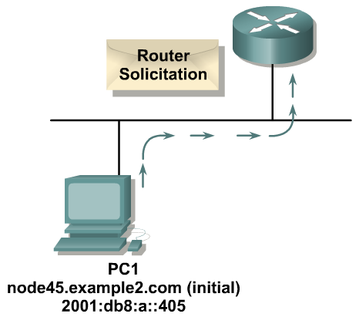
A Standard Stateless Autoconfiguration
Stage 1: The PC sends a router solicitation to request a prefix for stateless autoconfiguration.
Notes:
The PC first configures its link-local address and then sends a router solicitation to request a prefix for stateless autoconfiguration.

Slide 25
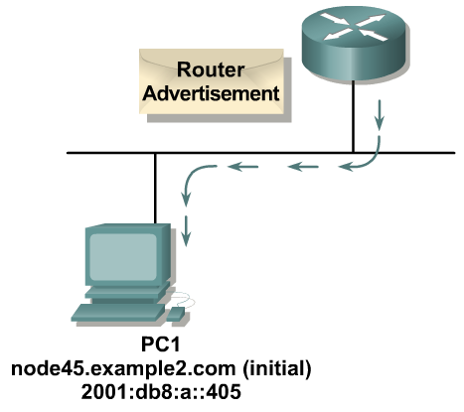
A Standard Stateless Autoconfiguration (Cont.)
Stage 2: The router replies with a router advertisement.
Notes:
The router replies with a router advertisement, including prefix information.

Slide 26
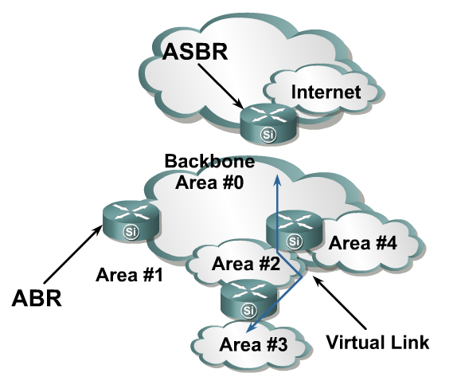
OSPFv3—Hierarchical Structure
Topology of an area is invisible from outside of the area:
  LSA flooding is bounded by area.
  SPF calculation is performed separately for each area.
Backbones must be contiguous.
All areas must have
a connection to
the backbone:
  Otherwise a virtual
  link must be used to
  connect to the
  backbone.
Notes:
OSPFv3, which is described in RFC 2740, supports IPv6.
OSPF is a routing protocol for IP. It is a link-state protocol. A link-state protocol makes its routing decisions based on the states of the links that connect source and destination machines.
The state of a link is a description of that interface and its relationship to its neighboring networking devices. The interface information includes the IPv6 prefix of the interface, the network mask, the type of network it is connected to, the routers connected to that network, and so on.
This information is propagated in various types of link-state advertisements (LSAs). A router’s collection of LSA data is stored in a link-state database (LSDB). The contents of the database, when subjected to Dijkstra’s algorithm, result in the creation of the OSPF routing table.
The difference between the database and the routing table is that the database contains a complete collection of raw data; the routing table contains a list of shortest paths to known destinations via specific router interface ports.

Slide 27
OSPFv3—Similarities with OSPFv2
OSPFv3 is OSPF for IPv6 (RFC 2740):
  Based on OSPFv2, with enhancements
  Distributes IPv6 prefixes
  Runs directly over IPv6
OSPFv3 & v2 can be run concurrently, because each address family has a separate SPF (ships in the night).
OSPFv3 uses the same basic packet types as OSPFv2:
  Hello
  Database description blocks (DDB)
  Link state request (LSR)
  Link state update (LSU)
  Link state acknowledgement (ACK)
Notes:
Although most of the algorithms of OSPFv2 are the same in OSPFv3, some changes have been made in OSPFv3, particularly to handle the increased address size in IPv6 and the fact that OSPF runs directly over IP.
Other similarities to OSPFv2 include:
OSPFv3 uses the same basic packet types as OSPFv2, such as hello, database description (DBD) (also called database description packets [DDP]), link-state request (LSR), link-state update (LSU), and LSA.
Mechanisms for neighbor discovery and adjacency formation are identical.
Operations of OSPFv3 over the RFC-compliant nonbroadcast multiaccess (NBMA) and point-to-multipoint topology modes are supported. OSPFv3 also supports the other modes from Cisco such as point-to-point and broadcast including the interface.
LSA flooding and aging are the same for both OSPFv2 and OSPFv3.

Slide 28
OSPFv3—Similarities with OSPFv2
Neighbor discovery and adjacency formation mechanism are identical.
RFC compliant NBMA and point-to-multipoint topology modes are supported. Also supports other modes from Cisco such as point-to-point and broadcast, including the interface.
LSA flooding and aging mechanisms are identical.
Notes:
Because OSPFv2 is heavily dependent on the IPv4 address for its operation, changes were necessary in the OSPFv3 protocol to support IPv6, as outlined in RFC 2740 OSPF for IPv6. Some of the notable changes include platform-independent implementation, protocol processing per-link rather than per-node processing, explicit support for multiple instances per link, and changes in authentication and packet format.
IPv6 OSPF is now an Internet Engineering Task Force (IETF) proposed standard. Like RIPng, IPv6 OSPFv3 uses IPv6 for transport and uses link-local addresses as source address.
All of OSPF for IPv4 optional capabilities, including on-demand circuit support, not-so-stubby areas (NSSAs), and the extensions to Multicast OSPF (MOSPF), are also supported in OSPF for IPv6.

Slide 29
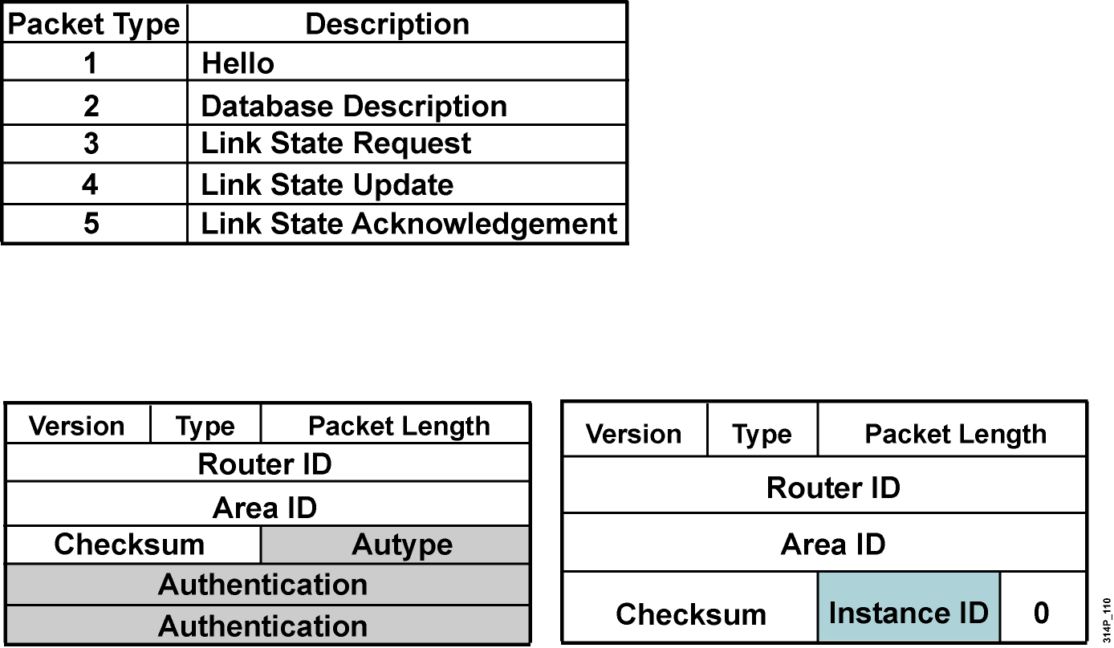
Enhanced Routing Protocol Support
Differences from OSPFv2
OSPFv3 has the same five packet types, but some fields have been changed.
All OSPFv3 packets have a 16-byte header verses the 24-byte header in OSPFv2.
Notes:
OSPFv2 was primarily concerned with the subnet on which it was operating, whereas OSPFv3 is concerned with the links to which the router is connected.
OSPFv2 did not define or allow for multiple instances per link, although similar functionality could be made by other mechanisms such as subinterfaces. OSPFv3 has explicit support for instances through the instance field.
Authentication is no longer part of OSPF; it is now the job of IPv6 to make sure the right level of authentication is in use.

Slide 30
OSPFv3—Differences from OSPFv2
OSPFv3 protocol processing per-link, not per-subnet:
IPv6 connects interfaces to links.
Multiple IPv6 subnets can be assigned to a single link.
Two nodes can talk directly over a single link, even though they do not share a common subnet.
The terms “network” and “subnet” are being replaced with “link”.
An OSPF interface now connects to a link instead of a subnet.
Notes:
OSPFv3 runs over a link: The network statement in the router subcommand mode of OSPFv2 is replaced by an OSPFv3 command to apply to the interface configuration. It is possible to have multiple instances per link.
Link-local address: OSPFv3 uses IPv6 link-local addresses to identify the OSPFv3 adjacency neighbors

Slide 31
OSPFv3—Differences from OSPFv2
Multiple OSPFv3 protocol instances can now run over a single link:
This allows for separate autonomous systems, each running OSPF, to use a common link. A single link could belong to multiple areas.
Instance ID is a new field that is used to have multiple OSPFv3 protocol instances per link.
In order to have two instances talk to each other, they need to have the same instance ID. By default it is 0, and for any additional instance it is increased.
Notes:
IPv6 uses the term “link” to indicate “a communication facility or medium over which nodes can communicate at the link layer.”
Interfaces connect to links. Multiple IP subnets can be assigned to a single link, and two nodes can talk directly over a single link, even if they do not share a common IP subnet (IPv6 prefix). For this reason, OSPF for IPv6 runs per-link instead of the IPv4 behavior of per-IP-subnet. The terms network and subnet used in the IPv4 OSPF specification should generally be replaced by link. Likewise, an OSPF interface now connects to a link instead of an IP subnet, etc.
This change affects the receiving of OSPF protocol packets, and the contents of hello packets and network LSAs.

Slide 32
OSPFv3—Differences from OSPFv2
Multicast addresses:
  FF02::5 – Represents all SPF routers on the link local scope; equivalent to 224.0.0.5 in OSPFv2.
  FF02::6 – Represents all DR routers on the link local scope; equivalent to 224.0.0.6 in OSPFv2.
Removal of address semantics:
  IPv6 addresses are no longer present in OSPF packet header (part of payload information).
  Router LSA and network LSA do not carry IPv6 addresses.
  Router ID, area ID, and link-state ID remains at 32 bits.
  DR and BDR are now identified by their router ID and no longer by their IP address.
Security:
  OSPFv3 uses IPv6 AH and ESP extension headers instead of variety of mechanisms defined in OSPFv2.
Notes:
Differences from OSPFv2 include the following:
Multicast addresses:
FF02::5 – Represents all shortest path first (SPF) routers on the link-local scope, equivalent to 224.0.0.5 in OSPFv2.
FF02::6 – Represents all designated routers (DRs) on the link-local scope, equivalent to 224.0.0.6 in OSPFv2.
Removal of address semantics:
IPv6 addresses are no longer present in the OSPF packet header (part of payload information).
Router LSAs and network LSAs do not carry IPv6 addresses.
Router ID, area ID and link-state ID remains at 32 bits.
DR and backup designated router (BDR) are now identified by their router ID and no longer by their IP address.
Security:
OSPFv3 uses IPv6 Authentication Header (AH) and Encapsulating Security Payload (ESP) extension headers instead of the variety of mechanisms defined in OSPFv2.

Slide 33
LSA Overview
 | LSA Function Code | LSA Type
Router-LSA | 1 | Ox2001
Network-LSA | 2 | Ox2002
Inter-Area-Prefix-LXA | 3 | Ox2003
Inter-Area-Router-LSA | 4 | Ox2004
AS-External-LSA | 5 | Ox4005
Group-Membership-LSA | 6 | Ox2006
Type-7-LSA | 7 | Ox2007
Link-LSA | 8 | Ox2008
Intra-Area-Prefix-LSA | 9 | Ox2009
Renamed
New
Notes:
OSPFv3 LSA features include:.
The LSA is composed of a router ID, area ID, and link-state ID. They are each 32 bits and are not derived from an IPv4 address.
Router LSAs and network LSAs contain only 32-bit IDs. They do not contain addresses.
LSAs have flooding scopes that define a diameter that they should be flooded to, as follows:
Link-local (flood all routers on-link)
Area (flood all routers within an OSPF area)
Autonomous system (AS) (flood all routers within the entire OSPF AS)
OSPFv3 supports the forwarding of unknown LSAs based on the flooding scope. This can be useful in an NSSA.
OSPFv3 now takes advantage of IPv6 multicasting, using FF02::5 for all OSPF routers and FF02::6 for the OSPF designated router and the OSPF BDR.
The two renamed LSAs are as follows:
Interarea prefix LSAs for area border routers (ABRs) (type 3): Type 3 LSAs advertise internal networks to routers in other areas (interarea routes). Type 3 LSAs may represent a single network or a set of networks summarized into one advertisement. Only ABRs generate summary LSAs. In OSPF for IPv6, addresses for these LSAs are expressed as prefix, prefix length instead of address, mask. The default route is expressed as a prefix with length 0.
Interarea router LSAs for Autonomous System Boundary Routers (ASBRs) (type 4): Type 4 LSAs advertise the location of an ASBR. Routers that are trying to reach an external network use these advertisements to determine the best path to the next hop. ASBRs generate type 4 LSAs.
The two new LSAs in IPv6 are as follows:
Link LSAs (type 8): Type 8 LSAs have link-local flooding scope and are never flooded beyond the link with which they are associated. Link LSAs provide the link-local address of the router to all other routers attached to the link, inform other routers attached to the link of a list of IPv6 prefixes to associate with the link, and allow the router to assert a collection of options bits to associate with the network LSA that will be originated for the link.
Intra-area prefix LSAs (type 9): A router can originate multiple intra-area prefix LSAs for each router or transit network, each with a unique link-state ID. The link-state ID for each intra-area prefix LSA describes its association to either the router LSA or the network LSA. The link-state ID also contains prefixes for stub and transit networks.

Slide 34
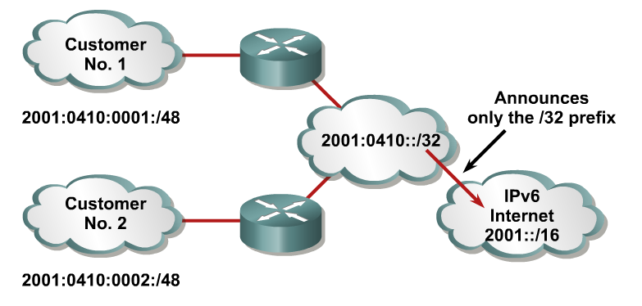
Larger Address Space Enables
Address Aggregation
Aggregation of prefixes announced in the global routing table
Efficient and scalable routing
Improved bandwidth and functionality for user traffic
Notes:
An address prefix occurs in almost all newly defined LSAs. The prefix is represented by the following three fields: Prefix Length, Prefix Options, and Address Prefix.
In OSPF for IPv6, addresses for these LSAs are expressed as prefix, prefix length instead of address, mask.
The default route is expressed as a prefix with length 0.
Type 3 and type 9 LSAs carry all IPv6 prefix information, which, in IPv4, is included in router LSAs and network LSAs.

Slide 35
Configuring OSPFv3 in Cisco IOS Software
Similar to OSPFv2:
  Prefixing existing Interface and exec mode commands with “ipv6”
Interfaces configured directly:
  Replaces network command
“Native” IPv6 router mode:
  Not a submode of router ospf command
Notes:
OSPFv3 has the following Cisco IOS attributes:
Network area command: The way to identify IPv6 networks that are part of the OSPFv3 network is different than with OSPFv2 configuration. The network area command in OSPFv2 is replaced by a configuration in which interfaces are directly configured to specify that IPv6 networks are part of the OSPFv3 network.
Native IPv6 router mode: The configuration of OSPFv3 is not a subcommand mode of the router ospf command (as it is in OSPFv2 configuration).

Slide 36
IPv6 and OSPFv3 Commands
Command | Description
Router(config)#ipv6 unicast-routing | Enables the forwarding of IPv6 unicast datagrams.
Router(config)#ipv6 router ospf process-id | Enables an OSPF process on the router. The process-id parameter identifies a unique OSPFv3 process. This command is used on a global basis.
Example: Router(config)#ipv6 router ospf 1 | Enables the OSPFv3 process number 1 on the router.
Router (config-router)# router-id router-id | For an IPv6-only router, a router-id parameter must be defined in the OSPFv3 configuration as an IPv4 address using the router-id router-id command. You can use any IPv4 address as the router-id value.
Example: Router (config-router)# router-id 2.2.2.2 | Identifies 2.2.2.2 as the router-id for this router. It must be unique on each router
Notes:
Routing of IPv6 unicast datagrams is disabled by default. To enable forwarding of IPv6 unicast datagrams, use the ipv6 unicast-routing command in global configuration mode.
Identify an OSPF process on the router using the ipv6 router ospf process-id command in global configuration mode. The process-id is an internal identification. It is locally assigned and can be a positive integer from 1 to 65535. The number used here is the number assigned administratively when enabling the OSPF for IPv6 routing process.

Slide 37
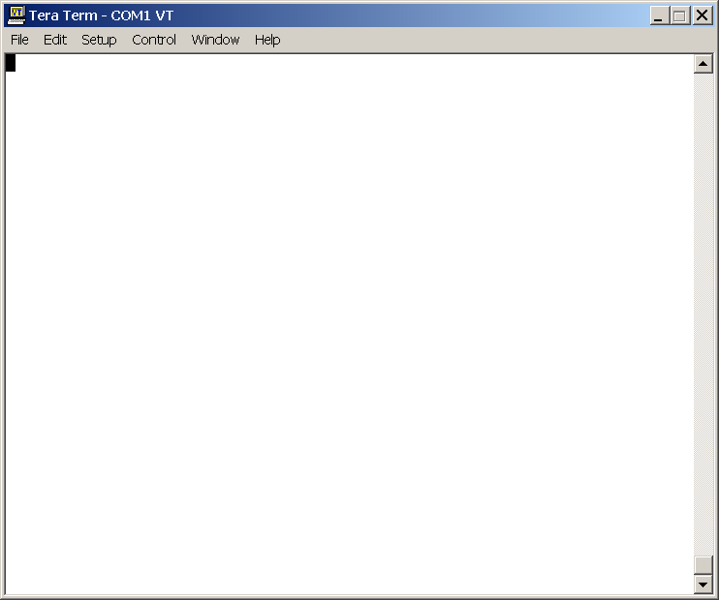
Enabling OSPFv3 Globally
router#
router# configure terminal
router(config)# ipv6 unicast-routing
router(config)# ipv6 router ospf 1
router(config-router) router-id 2.2.2.2
Notes:
This example shows the router commands for enabling OSPF globally:
The forwarding of IPv6 datagrams is enabled using the unicast-routing command.
The OSPF process is started with process ID 1.
The router is given router ID 2.2.2.2

Slide 38
Steps for Enabling IPv6 and OSPFv3 on an Interface
Step | Command or Action | Purpose
1 | Router(config)#interface type number | Specifies an interface type and number, and places the router in interface configuration mode.
2 | Router(config-if)#ipv6 address address/prefix-length [eui-64] | Configures an IPv6 address for an interface and enables IPv6 processing on the interface. The eui-64 parameter forces the router to complete the addresses’ low-order 64-bits by using an EUI-64 interface ID.
3 | Router(config-if)#ipv6 ospf process-id area area-id [instance instance-id] | Enables OSPF for IPv6 on an interface.
4 | Router(config-if)#router ospf priority priority number | Priority number is used in the designated router election.
5 | Router(config-if)#router ospf cost cost | The cost of sending a packet on the interface, expressed in the link state metric.
Notes:
To enable IPv6 for OSPFv3 on an interface:
Enter interface configuration mode
Assign an IPv6 address for the interface. This enables IPv6 processing on the interface. The [eui-64] parameter creates an IPv6 address using the interface ID. Configures site-local and global IPv6 addresses with an interface identifier (ID) in the low-order 64 bits of the IPv6 address. Only the 64-bit network prefix for the address needs to be specified; the last 64 bits are automatically computed from the interface ID.
Enable OSPF for IPv6 on the interface using the ipv6 ospf process-id area area-id [instance instance-id] command. An OSPF instance (also known as an OSPF process) can be considered a logical router running OSPF in a physical router. Use the instance ID to control selection of other routers as your neighbors. You become neighbors only with routers that have the same instance ID.
To set the router priority, which helps determine the designated router for this network, use the ipv6 ospf priority command. To return to the default value, use the no form of this command.
To explicitly specify the cost of sending a packet on an interface, use the ipv6 ospf cost command. You can set the metric manually using this command, if you need to change the default.

Slide 39
Enabling OSPFv3 on an Interface
router(config)# interface Ethernet0/0
router(config)# ipv6 address 3FFE:FFFF:1::1/64
router(config)# ipv6 ospf 1 area 0
router(config)# ipv6 ospf priority 20
router(config)# ipv6 ospf cost 20
Notes:
This example shows a configuration for IPv6 on the Ethernet 0/0 interface:
Enter interface configuration mode
IPv6 address is configured for the interface: 3FFE:FFFF:1::1/64
OSPF for IPv6 is enabled on the interface for OSPF process 1, area 0.
The router priority is set to 20.
OSPF cost is set to 20.

Slide 40
Cisco IOS OSPFv3 Specific Attributes
Configuring area range:
  area area-id range prefix/prefix length [advertise | not-advertise] [cost cost]
Showing new LSAs:
  show ipv6 ospf [process-id] database link
  show ipv6 ospf [process-id] database prefix
Notes:
To consolidate and summarize routes at an area boundary use the IPv6 OSPF router command:
area area-id range ipv6-prefix/ prefix-length [advertise | not-advertise] [cost cost].
For example:
Router(config)#ipv6 router ospf 1
Router(config-rtr)#area range 1 2001:0DB8::/48
The cost of the summarized routes will be the highest cost of the routes being summarized. For example, if the following routes are summarized:
OI 2001:0DB8:0:0:7::/64 [110/20]
via FE80::A8BB:CCFF:FE00:6F00, Ethernet0/0
OI 2001:0DB8:0:0:8::/64 [110/100]
via FE80::A8BB:CCFF:FE00:6F00, Ethernet0/0
OI 2001:0DB8:0:0:9::/64 [110/20]
via FE80::A8BB:CCFF:FE00:6F00, Ethernet0/0
They become one summarized route, as follows:
OI 2001:0DB8::/48 [110/100]
via FE80::A8BB:CCFF:FE00:6F00, Ethernet0/0

Slide 41
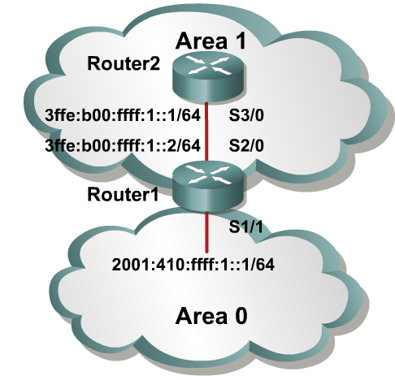
OSPFv3 Configuration Example
Router1#
interface S1/1
ipv6 address 2001:410:FFFF:1::1/64
ipv6 ospf 100 area 0
interface S2/0
ipv6 address 3FFE:B00:FFFF:1::2/64
ipv6 ospf 100 area 1
ipv6 router ospf 100
router-id 10.1.1.3
Router2#
interface S3/0
ipv6 address 3FFE:B00:FFFF:1::1/64
ipv6 ospf 100 area 1
ipv6 router ospf 100
router-id 10.1.1.4
Notes:
The example shows an OSPF network of two routers, with an area 0 and area 1.
The interface-specific command ipv6 ospf 100 area 0 will create the “ipv6 router ospf 100” process dynamically, as will the ipv6 ospf 100 area 1 command.

Slide 42
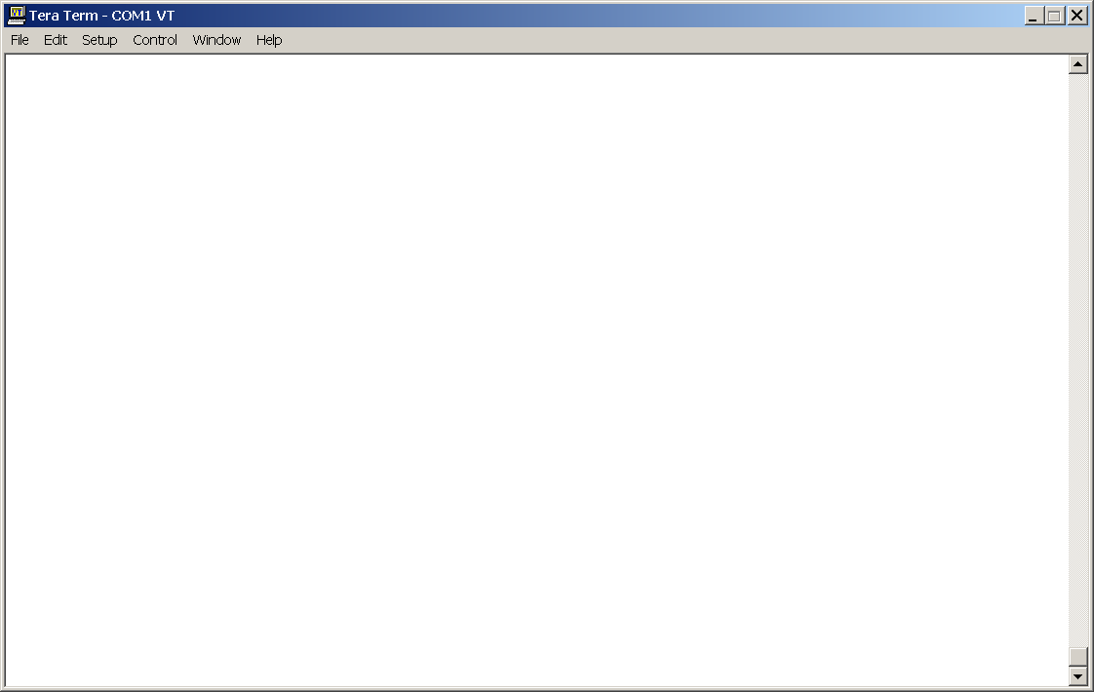
Verifying Cisco IOS OSPFv3
Router2#show ipv6 ospf int s 3/0
S3/0 is up, line protocol is up
Link Local Address 3FFE:B00:FFFF:1::1, Interface ID 7
Area 1, Process ID 100, Instance ID 0, Router ID 10.1.1.4
Network Type POINT_TO_POINT, Cost: 1
Transmit Delay is 1 sec, State POINT_TO_POINT,
Timer intervals configured, Hello 10, Dead 40, Wait 40, Retransmit 5
Hello due in 00:00:02
Index 1/1/1, flood queue length 0
Next 0x0(0)/0x0(0)/0x0(0)
Last flood scan length is 3, maximum is 3
Last flood scan time is 0 msec, maximum is 0 msec
Neighbor Count is 1, Adjacent neighbor count is 1
Adjacent with neighbor 10.1.1.3
Suppress hello for 0 neighbor(s)
Notes:
There are several commonly used OSPFv3 show commands, including the show ipv6 ospf [process-id][area-id] interface [interface] command. This command displays OSPF-related interface information, as displayed in the figure.
The clear ipv6 ospf [ process-id] {process |force-spf | redistribution | counters [neighbor[ neighbor-interface | neighbor-id]]} command triggers SPF recalculation and repopulation of the Routing Information Base (RIB).
Displays information about the OSPF process on this interface:
Status of the physical link and operational status of protocol.
Interface IPv6 address.
The area ID, process ID, instance ID, and router ID of the area from which this route is learned.
Network type and link-state cost.
Transmit delay, interface state, and router priority.
Designated router ID and respective interface IP address.
Backup designated router ID and respective interface IP address.
Configuration of timer intervals.
Number of seconds until the next hello packet is sent out this interface.
Count of network neighbors and list of adjacent neighbors.

Slide 43
show ipv6 ospf
R7#show ipv6 ospf
Routing Process “ospfv3 1” with ID 75.0.7.1
It is an area border and autonomous system boundary router
Redistributing External Routes from, connected
SPF schedule delay 5 secs, Hold time between two SPFs 10 secs
Minimum LSA interval 5 secs. Minimum LSA arrival 1 secs
LSA group pacing timer 240 secs
Interface floor pacing timer 33 msecs
Retransmission pacing timer 33 msecs
Number of external LSA 3. Checksum Sum 0x12B75
Notes:
Process ID and OSPF router ID.
Configured LSA group pacing timer (in seconds).
Configured LSA flood pacing timer (in milliseconds).
Configured LSA retransmission pacing timer (in milliseconds).
Number of areas in router, area addresses, etc.

Slide 44
show ipv6 ospf (Cont.)
Number of areas in this router is 2. 1 normal 0 stub 1 nssa
Area BACKBONE(0)
Number of interfaces in this area is 1
SPF algorithm executed 23 times
Number of LSA 14. Checksum Sum 0x760AA
Number of DCbitless LSA 0
Number of Indication LSA 0
Number of DoNotAge LSA 0
Flood list length 0
Area 2
Number of interfaces in this area is 1
It is a NSSA area
Perform type-7/type-5 LSA translation
SPF algorithm executed 17 times
Number of LSA 25. Checksum Sum 0xE3BF0
Number of DCbitless LSA 0
Number of Indication LSA 0
Number of DoNotAge LSA 0

Slide 45
show ipv6 ospf neighbor detail
Router2#show ipv6 ospf neighbor detail
Neighbor 10.1.1.3
In the area 0 via interface S2/0
Neighbor: interface-id 14, link-local address 3FFE:B00:FFFF:1::2
Neighbor priority is 1, State is FULL, 6 state changes
Options is 0x63AD1B0D
Dead timer due in 00:00:33
Neighbor is up for 00:48:56
Index 1/1/1, retransmission queue length 0, number of retransmission 1
First 0x0(0)/0x0(0)/0x0(0) Next 0x0(0)/0x0(0)/0x0(0)
Last retransmission scan length is 1, maximum is 1
Last retransmission scan time is 0 msec, maximum is 0 msec
Notes:
Some parameters displayed by this command:
Neighbor router ID
Area and interface through which the OSPF neighbor is known
Router priority of the neighbor, neighbor state
OSPF state
Number of state changes since the neighbor was created
Hello packet options field contents
Expected time before Cisco IOS software will declare the neighbor dead
Number of hours:minutes:seconds since the neighbor went into two-way state

Slide 46
show ipv6 ospf database
Router Link States (Area 1)
ADV Router Age Seq# Fragment ID Link count Bits
26.50.0.1 1812 0x80000048 0 1 None
26.50.0.2 1901 0x80000006 0 1 B
Net Link States (Area 1)
ADV Router Age Seq# Link ID Rtr count
26.50.0.1 57 0x8000003B 3 4
Inter Area Prefix Link States (Area 1)
ADV Router Age Seq# Prefix
26.50.0.2 139 0x80000003 3FFE:FFFF:26::/64
26.50.0.2 719 0x80000001 3FFE:FFF:26::/64
Inter Area Router Link States (Area 1)
ADV Router Age Seq# Link ID Dest RtrID
26.50.0.2 772 0x80000001 1207959556 72.0.0.4
26.50.0.4 5 0x80000003 1258292993 75.0.7.1
Notes:
To display lists of information related to the OSPF database for a specific router, use the show ipv6 ospf database command in EXEC mode. The various forms of this command deliver information about different OSPF link-state advertisements (LSAs).

Slide 47
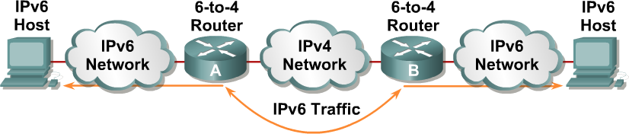
IPv4-to-IPv6 Transition
Transition richness means:
No fixed day to convert; no need to convert all at once.
Different transition mechanisms are available:
  Smooth integration of IPv4 and IPv6
  Use of dual stack or 6-to-4 tunnels
Different compatibility mechanisms:
  IPv4 and IPv6 nodes can communicate
Notes:
The transition from IPv4 does not require upgrades on all nodes at the same time. Many transition mechanisms enable smooth integration of IPv4 and IPv6. Other mechanisms that allow IPv4 nodes to communicate with IPv6 nodes are available. All of these mechanisms are applied to different situations.
The two most common techniques to transition from IPv4 to IPv6 are as follows:
Dual stack
IPv6-to-IPv4 (6-to-4) tunnels
For communication between IPv4 and IPv6 networks, there can be IPv4 addresses that are encapsulated in an IPv6 address.
The figure shows an example of a transition and integration mechanism. The 6-to-4 routers automatically encapsulate the IPv6 traffic inside IPv4 packets.

Slide 48
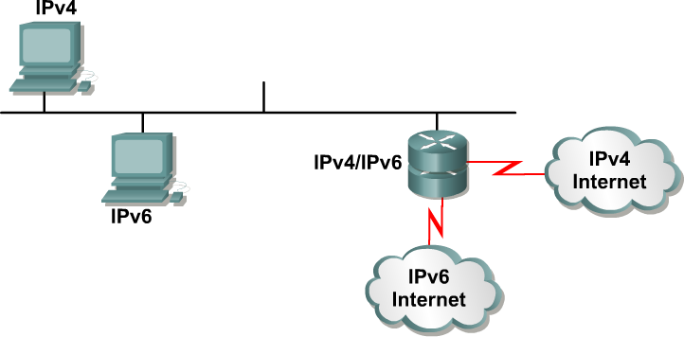
Dual Stack
Dual stack is an integration method where a node has “implementation and connectivity” to both an IPv4 and IPv6 network.
Notes:
Dual stack is an integration method where a node has implementation and connectivity to both an IPv4 and IPv6 network, and thus the node has two stacks. This configuration can be accomplished on the same interface or on multiple interfaces.
A dual-stack node chooses which stack to use based on destination address. A dual-stack node should prefer IPv6 when available. The dual-stack approach to IPv6 integration, in which nodes have both IPv4 and IPv6 stacks, will be one of the most commonly used methods. Old IPv4-only applications continue to work as before. New and modified applications take advantage of both IP layers.
A new application program interface (API) is defined to support both IPv4 and IPv6 addresses and Domain Name System (DNS) requests. This new API replaces the “gethostbyname” and “gethostbyaddr” calls. A converted application will be able to make use of both IPv4 and IPv6. An application can be converted to the new API while still using only IPv4.
Past experience in porting IPv4 applications to IPv6 says that, for most applications, it is a minimal change in some localized places inside the source code. This technique is well-known and has been applied in the past for other protocol transitions. It enables gradual application upgrades one-by-one to IPv6.

Slide 49
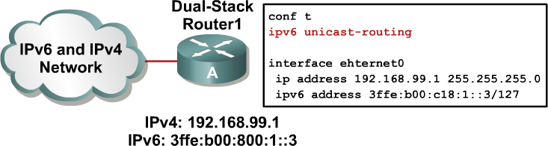
Cisco IOS Software Is IPV6-Ready:
Cisco IOS Dual Stack
If both IPv4 and IPv6 are configured on an interface, this interface is dual-stacked.
Notes:
Cisco IOS software is IPv6-ready. As soon as IPv4 and IPv6 basic configurations are complete on the interface, the interface is dual-stacked, and it forwards IPv4 and IPv6 traffic.
Using IPv6 on a Cisco IOS router requires that you use the global configuration command ipv6 unicast-routing. This command enables the forwarding of IPv6 datagrams. All interfaces that forward IPv6 traffic must have an IPv6 address. The interface command is as follows:
ipv6 address IPv6-address [/prefix length]
This command specifies an IPv6 network assigned to the interface and enables IPv6 processing on the interface.

Slide 50
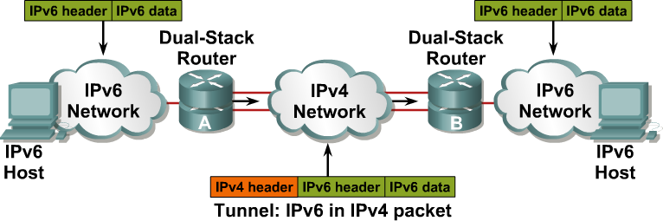
Tunneling
Tunneling is an integration method where an IPv6 packet is encapsulated within another protocol, such as IPv4. This method of encapsulation is IPv4 protocol 41:
  This includes a 20-byte IPv4 header with no options and an IPv6 header and payload.
  This is considered dual stacking.
Notes:
Tunneling is an integration method where an IPv6 packet is encapsulated within another protocol, such as IPv4. This method of encapsulation is IPv4 protocol 41:
This includes a 20-byte IPv4 header with no options and an IPv6 header and payload.
This is considered dual stacking.
Tunnels are often used in networking to overlay noncompatible functionality over an existing network. When tunneling IPv6 traffic over an IPv4 network, one edge router encapsulates the IPv6 packet inside an IPv4 packet and then the other router decapsulates it, and vice versa. This enables the connection of IPv6 islands without the need to also convert an intermediary network to IPv6. Tunneling presents these two issues:
The MTU is effectively decreased by 20 octets (if the IPv4 header does not contain any optional field).
A tunneled network is often difficult to troubleshoot. Tunneling is an intermediate integration/transition technique that should not be considered a final solution. Native IPv6 architecture should be the ultimate goal.

Slide 51
Cisco IOS Software Is IPv6-Ready:
Overlay Tunnels
Tunneling encapsulates the IPv6 packet in the IPv4 packet.
Notes:
Networking often uses tunnels to overlay an incompatible functionality over an existing network. Tunneling IPv6 traffic over an IPv4 network requires one edge router to encapsulate the IPv6 packet inside an IPv4 packet and another router to de-encapsulate it.
This process enables you to connect the IPv6 islands without converting the entire network to IPv6.

Slide 52
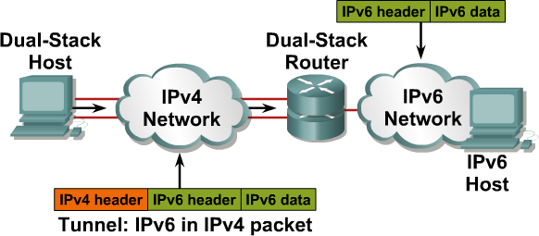
“Isolated” Dual-Stack Host
Encapsulation can be done by edge routers between hosts or between a host and a router.
Notes:
Encapsulation can be done by edge routers between hosts or between a host and a router. This example shows an isolated dual-stack host using an encapsulated tunnel to connect to the edge router of the IPv6 network.
Tunneling will not work if an intermediary node between the two end points of the tunnel, such as a firewall, filters out IPv4 protocol 41, which is the IPv6 in IPv4 encapsulation.

Slide 53
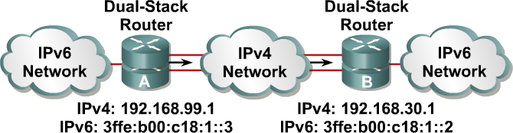
Cisco IOS Software Is IPv6-Ready: Configured Tunnel
Configured tunnels require:
  Dual-stack endpoints
  IPv4 and IPv6 addresses configured at each end
Notes:
In a manually configured tunnel, you configure both the IPv4 and IPv6 addresses statically. Perform this configuration on the routers at each end of the tunnel.
These end routers must be dual-stacked, and the configuration cannot change dynamically as network and routing needs change. Routing must be set up properly to forward a packet between the two IPv6 networks.
Tunnel end points can be unnumbered, but unnumbered end points make troubleshooting difficult. The IPv4 practice of saving addresses for tunnel end points is no longer an issue.

Slide 54
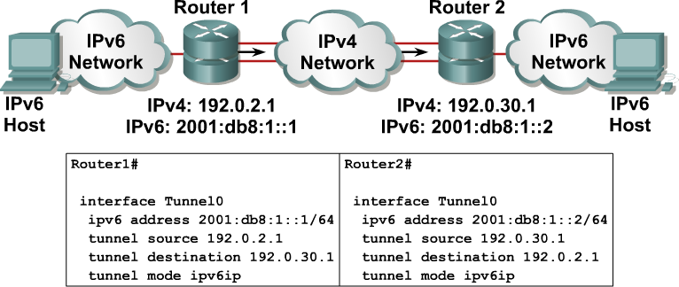
Example: Cisco IOS Tunnel Configuration
Notes:
The example shows the configuration of two Cisco routers connected with IPv6 through IPv4 encapsulation.
The command interface Tunnel0 is used, with the tunnel source and destination specified with the underlying network addresses, which are IPv4 addresses. A static IPv6 address is configured on the tunnel0 interface.
The command that enables the IPv6-over-IPv4 tunneling is tunnel mode ipv6ip.

Slide 55
Configuring static routes for 6-to-4 tunnels
A 6-to-4 tunnel establishes a transient link between IPv6 domains which are connected by an IPv4 backbone
Create a tunnel interface
Set tunnel mode with the tunnel mode ipv6ip 6to4 command
Create an IPv6 specific address
Set the source interface for the tunnel
Configure an Ipv6 static route
Notes:
1. A tunnel is a logical interface that acts like a logical connection between two endpoints.
It is similar to a loopback interface in that more than one interface is involved.
2. The tunnel mode ipv6ip 6to4 command constructs an automatic tunnel which determines the tunnel’s destination.
3. A 6-4 tunnel uses special IPv6 addresses in the 2002::/16 address range
A 6-4 tunnel does not require a destination address because it is no a point-to-point link.
4. Tunnel source is the interface of the router usually the serial interface that traffic will originate from.
5.

Slide 56
Converting IPv4 addresses to IPv6 for
6-4 Tunnel
A 6-4 tunnel uses special addresses in the 2002::/16 address space
The first 16 bits are the hexadecimal number 2002
The next 32 bits are the original source address in hexadecimal form
The IPv4 address of 172.16.12.1 is converted into AC10:0C01
The complete address would be 2002:AC10:0c01:1::1/64
Notes:
The 1 at the end of the address is a more specific subnet
The 1 at the end is the host address
/64 is the subnet

Slide 57

Configuration example for 6-to-4 tunnel between R1 and R3
Lo0 10.1.2.1/24
172.16.23.1 /24 S0/0/1
R2
S0/0/1 172.16.23.2 /24
Lo0 10.1.3.1/24
S0/0/0 172.16.12.2 /24
R3
172.16.12.1 /24 S0/0/0
R1
Lo0 10.1.1.1/24
R1
R1(config-if)# interface tunnel 0
R1(config-if)# tunnel mode 1pv6ip to 6to4
R1(config-if)# ipv6 address 2002:AC10:0C01:1::1/64
R1(config-if)# tunnel source s0/0/0
Exit
R1(config)# ipv6 route 2002::/16 tunnel 0
Verification
R1#ping 2002:AC10:1703:1::3
R3
R3(config-if)# interface tunnel 0
R3(config-if)# tunnel mode 1pv6ip to 6to4
R3(config-if)# ipv6 address 2002:AC10:1703:1::3/64
R3(config-if)# tunnel source s0/0/1
Exit
R3(config)# ipv6 route 2002::/16 tunnel 0
Verification
R3#ping 2002:AC10:1::1
Notes:
The following example creates a tunnel between R1 and R3’s loopback interfaces.
The static route automatically routes all 2002::/16 address through the tunnel.
The ipv6 route 2002::/16 tunnel 0 command sets up a static route for the whole 2002::/16

Slide 58
IPv6 Tunnel Static Route Configuration
Lo0 10.1.2.1/24
172.16.23.1 /24 S0/0/1
R2
S0/0/1 172.16.23.2 /24
Lo0 10.1.3.1/24
S0/0/0 172.16.12.2 /24
R3
172.16.12.1 /24 S0/0/0
R1
Lo0 10.1.1.1/24
Router 1
Router1(config)# ipv6 unicast-routing
Router1(config)# ipv6 route FEC0::30/112 2002:AC10:1703:1::3
Router 2
Router2(config)# ipv6 unicast-routing
Router2(config)# ipv6 route FEC0::1:0/112 2002:AC10:C01:1::1
The next hop for both routers is the IPv6 address at the other end of the tunnel
Notes:
The previous example created a static route allowing 2002::/16 address to pass through a 6to4 tunnel
This example creates a static route between R1 and R3’s loopback interface and vice versa.
The next hop for both routers is the

Slide 59
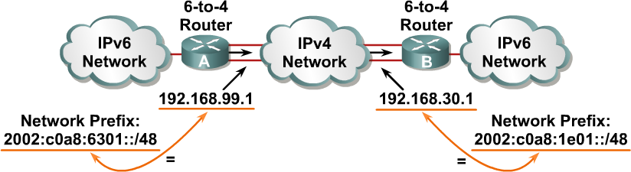
Cisco IOS Software Is IPv6-Ready: 6-to-4 Tunneling
6-to-4:
  Is an automatic tunnel method
  Gives a prefix to the attached IPv6 network
Notes:
The 6-to-4 tunneling method automatically establishes the connection of IPv6 islands through an IPv4 network. The 6-to-4 tunneling method applies a valid IPv6 prefix to each IPv6 island, which enables the fast deployment of IPv6 in a corporate network without address retrieval from the Internet service providers (ISPs) or registries.
The 6-to-4 tunneling method requires a special code on the edge routers, but the IPv6 hosts and routers inside the 6-to-4 site do not require new features to support 6-to-4. Each 6-to-4 site receives a /48 prefix, which is the concatenation of 0x2002 and the hexadecimal IPv4 address of the edge router.
For example, if the IPv4 address of the edge router is 192.168.99.1, the prefix of its IPv6 network is 2002:c0a8:6301::/48, because c0a86301 is the hexadecimal representation of 192.168.99.1. The IPv6 network can substitute any IP address in the space after the first 16-bit section (0x2002).
When an IPv6 packet with a destination address in the range of 2002::/16 reaches the 6-to-4 edge router, the 6-to-4 edge router extracts the IPv4 address that is embedded in the 2002:: destination address (inserted between the third and sixth octets inclusively). The 6-to-4 router then encapsulates the IPv6 packet in an IPv4 packet with the destination IPv4 address that was extracted from inside the IPv6 destination address.
This IPv4 address represents the address of the other 6-to-4 edge router of the destination 6-to-4 site. The destination edge router de-encapsulates the IPv6 packet in the IPv4 packet and then forwards the native packet toward its final destination.

Slide 60
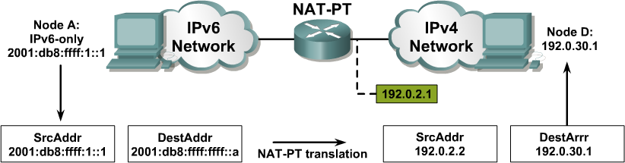
Translation – NAT-PT
NAT-Protocol Translation (NAT-PT) is a translation mechanism that sits between an IPv6 network and an IPv4 network.
The job of the translator is to translate IPv6 packets into IPv4 packets and vice versa.
Notes:
For legacy equipment that will not be upgraded to IPv6 and for some deployment scenarios, techniques that can connect IPv4-only nodes on IPv6-only nodes are available. Translation is basically an extension of NAT techniques.
The example on this page shows the translation of an IPv6 datagram sent from node A to node D. From the perspective of node A, it is establishing a communication to another IPv6 node. One advantage of NAT-PT is that no modifications are required on IPv6 node A; all it needs to know is the IPv6 address mapping to the IPv4 address of node D. This mapping can be obtained dynamically from the DNS server.
IPv4 node D can also send a datagram to node A by using the IPv4 address mapped to the IPv6 address of node A. Again, from the perspective of node D, it is establishing an IPv4 communication to its correspondent. Again, node D requires no modification.

